Slide 1


Building
Peter Veres
peter_veres2@epam.com
2017

Slide 2

What is maven?
Maven in Real Projects

Slide 3
What is maven?
“Maven is a project management tool which encompasses a project object model, a set of standards, a project lifecycle, a dependency management system, and logic for executing plugin goals at defined phases in a lifecycle. When you use Maven, you describe your project using a well-defined project object model, Maven can then apply cross-cutting logic from a set of shared (or custom) plugins.”
From http://maven.apache.org/

Slide 4
Concepts
Maven in Real Projects

Slide 5

Convention Over Configuration

Slide 6
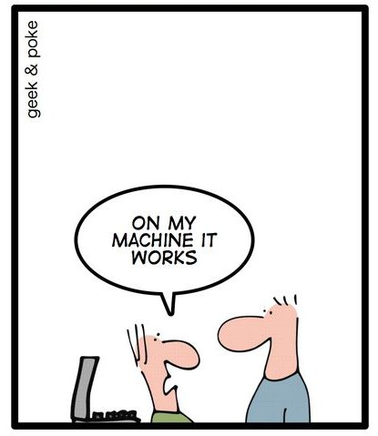
Common Interface
How do you run unit tests?
What does the project need to build?
What libraries do I need to download?
...
mvn install

Slide 7
Maven Plugins
Delegate most responsibility to a set of Maven Plugins
Core plugins
clean
compiler
deploy
failsafe
install
resources
site
surefire
verifier
Compiler plugin goals
compile
help
testCompile
Notes:
Maven is only a framework
Some core plugins exists, which be used (compiler, etc.)
Additional plugins can be added (pl. Checksyle, cobertura, etc)

Slide 8
Conceptual Model of a "Project"
Description of a software project
Attributes of the project
Enables features such as:
Dependency management
Remote repositories
Universal reuse of build logic
Tool Portability / Integration
Easy Searching and Filtering
<project>
<modelVersion>4.0.0</modelVersion>
<groupId>com.epam.app</groupId>
<artifactId>best-app</artifactId>
<version>1</version>
</project>

Slide 9
Declarative vs. Imperative
Program explicitly specifies process
Initial state
Results
What to do?
Program specifies desired final state
Initial state
Results
What we would like to have as the result?
Notes:
Requires a different mind-set – can be challenging at first, if you are used to Ant (or Make)
Some things are indeed more complicated
It's the best documentation on how to build your project
Try to decipher that from an Ant script

Slide 10
Default lifecycle
validate
initialize
generate-test-resources
prepare-package
pre-integration-test
generate-sources
process-test-sources
package
integration-test
process-sources
generate-test-resources
post-integration-test
generate-resources
process-test-resources
verify
process-resources
test-compile
install
compile
process-test-classes
process-classes
test
deploy
Notes:
phases: some dedicated phases
Default lifecycle
Validate: pom.xml is OK
Compile
Test
Package
Integration test
Verify
Install
Deploy
Clean lifecycle
Site lifecycle
Also can call the goals explicitly.
In evey .phase the plugins can do something
Also mention

Slide 11
Installing and using maven
Maven in Real Projects

Slide 12
Installing maven
Extract the distribution archive
Add the bin directory to your PATH
Set JAVA_HOME to the location of your JDK
To verify installation run
Optional: to specify JVM properties use the MAVEN_OPTS environment variable
mvn --version
$ unzip apache-maven-3.3.3-bin.zip
$ export PATH=$PATH:/.../apache-maven-3.3.3/bin/
$ export JAVA_HOME=/.../Java/jdk1.8.0_45/
$ mvn -version

Slide 13
Create a simple Java project with maven
mvn archetype:generate
-DgroupId=com.epam.training
-DartifactId=first-project
-DarchetypeArtifactId=maven-archetype-quickstart
first-project
|-pom.xml
|-src
|---main
|-----java
|-------com
|---------epam
|-----------training
|-------------App.java
|---test
|-----java
|-------com
|---------epam
|-----------training
|-------------AppTest.java
Also try the interactive mode!

Slide 14

Using the Maven Help Plugin
Available help goals: mvn help:describe -Dplugin=help
Effective POM: mvn help:effective-pom
Compiler plugin goals: mvn help:describe -Dplugin=compiler
Compiler plugin compile goal parameters: mvn help:describe -Dplugin=compiler -Dmojo=compile -Ddetail

Slide 15
Compile project
With lifecycle phases
With plugin goals (mojos)
Check Effective POM for lifecycle bindings
mvn clean package
mvn clean:clean compiler:compile compiler:testCompile surefire:test jar:jar
Compile and run the generated default archetype!

Slide 16
Deploy project
Add your artifact to a remote repository for sharing with other developers and projects
Internal network
Local repository
Remote repository
Central repository
Local repository
Deploy our first project to a remote repository!

Slide 17
Maven features
Maven in Real Projects

Slide 18
Coordinates
groupId
artifactId
version
packaging
[classifier]
<project>
<groupId>…</groupId>
<artifactId>...</artifactId>
<version>...</version>
<packaging>...</packaging>
...
</project>

Slide 19
Dependency resolution
Transitive Dependencies
Dependency mediation
Excluded dependencies
Optional dependencies
Dependency scope
Compile
Provided
Runtime
Test
System
Import
<project>
...
<dependencies>
<dependency>
<groupId>test</groupId>
<artifactId>a</artifactId>
<version>1.0</version>
<scope>runtime</scope>
</dependency>
</dependencies>
...
</project>

Slide 20
Multi-module projects
Parent module
<project>
<modules>
<module>simple-module1</module>
<module>simple-module2</module>
</modules>
[...]
</project>
Module1
Module2

Slide 21
Multi-module projects demo
calculator
Set Java version
<properties>
<maven.compiler.source>
1.8
</maven.compiler.source>
<maven.compiler.target>
1.8
</maven.compiler.target>
</properties>
packaging: pom
calculator-web
calculator-service
maven-archetype-webapp

Slide 22



IDE independence
POM
Import the multi-module project in eclipse!

Slide 23
How to…
Maven in Real Projects

Slide 24
Tests
Unit tests
Part of the default build lifecycle
Plugin: surefire
Integration tests
Part of the default build lifecycle
Plugin: failsafe
Not active by default
Convention: Fail the build when a test is broken
Consider generating coverage reports
Useful options
--fail-at-end / -fae
--fail-never / -fn
-Dmaven.test.failure.ignore=true
-Dmaven.test.skip=true
-DskipTests=true

Slide 25
Integration tests effectively
How to organize test sources?
Besides unit tests
In separate modules
Separate source folders (with build-helper-maven-plugin)
Use separate profile for long running integration tests

Slide 26
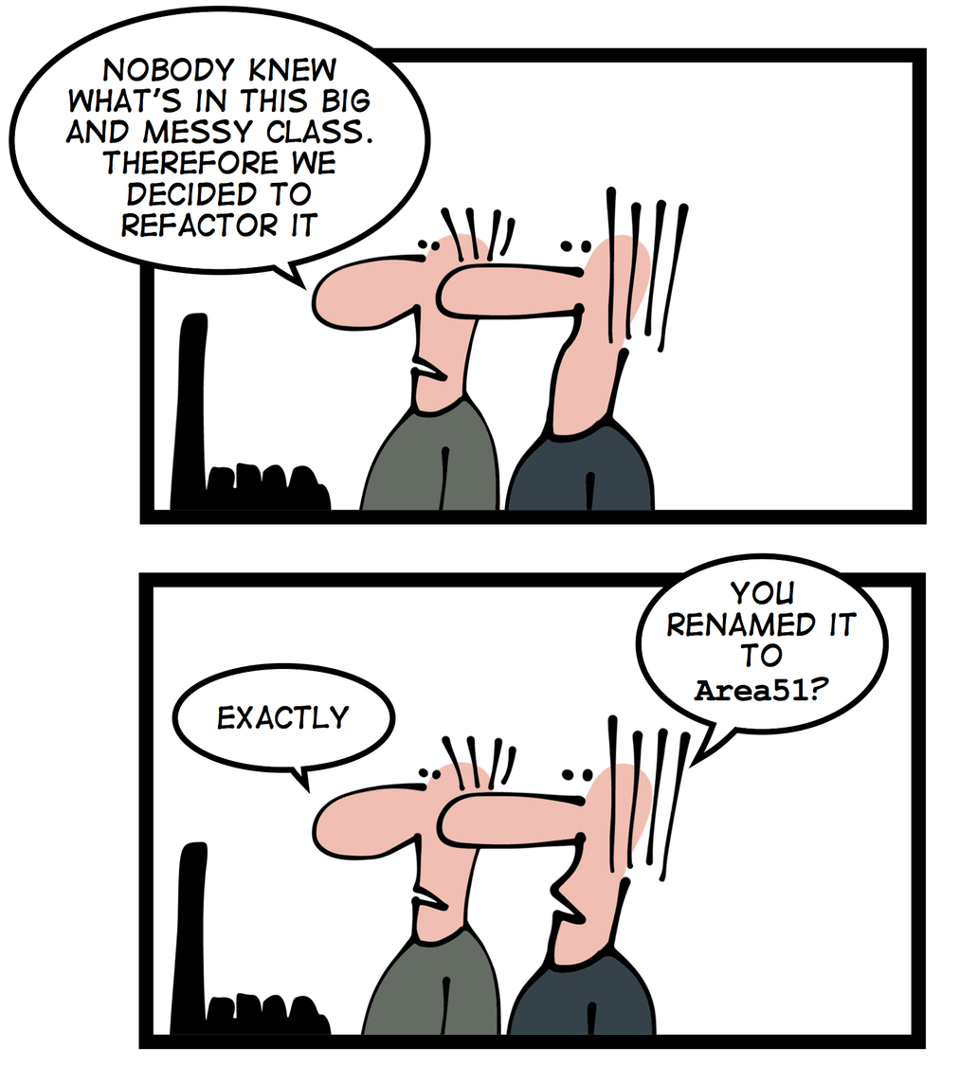
Source code quality checks
Consider using the checkstyle, findbugs, pmd plugins
Can be integrated with
the default build lifecycle
the reporting (site) lifecycle
Run the checkstyle plugin on one of the projects!

Slide 27

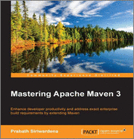
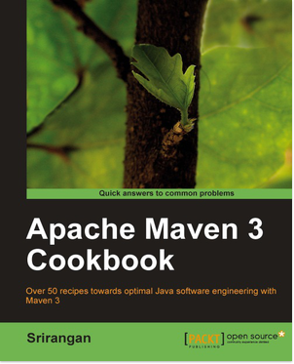
Recommended material
Mastering Apache Maven 3 by Prabath Siriwardena
Maven: The Definitive Guide by Sonatype Company
Apache Maven 3 Cookbook (Quick Answers to Common Problems) by Srirangan

